Slide 1
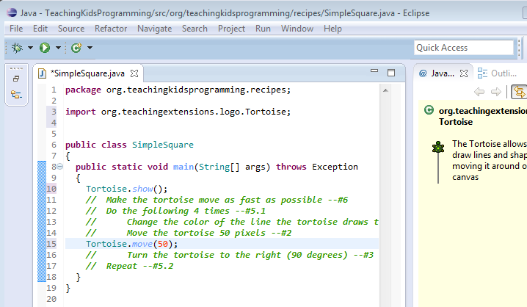

Setup
Yellow – PC
Orange – Mac & Linux
Install Java
Install Eclipse
The eclipse directory Matters.
Mac: /Applications/eclipse
Linux: /Applications/eclipse
PC: c:\eclipse
Unzip TeachingKidsProgramming.Java-master
click on the TKP_Launcher.jar
Important
make sure there are
no spaces
in the path to the launcher
When you’re done it should look like this

Slide 2
with The Intentional Method
By Lynn Langit & Llewellyn Falco

Slide 3







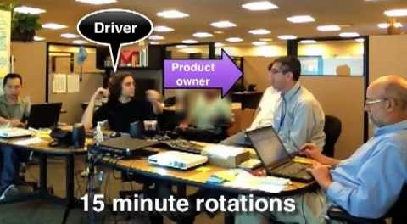


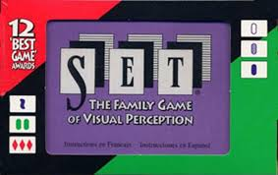
Lynn Langit
Llewellyn Falco
[.Net, Node, Java, Objective-C, Lua, Python, C++, Perl, Ruby, Php]
Mob Programming

Slide 4
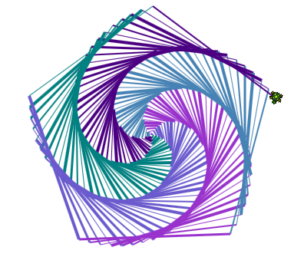


What is TKP?
US-based non-profit run by volunteer professional developers
Co-founders have been teaching kids for 7 years
Offers free and open-source courseware and teacher-training materials in Java
Designed for kids ages 11-17
Introduces core programming concepts
Used throughout the US and also world-wide

Slide 5

Core Principals
Free & Open Source
Fun for Girls and Boys
Java with a customized IDE
Implements XP technical practices

Slide 6

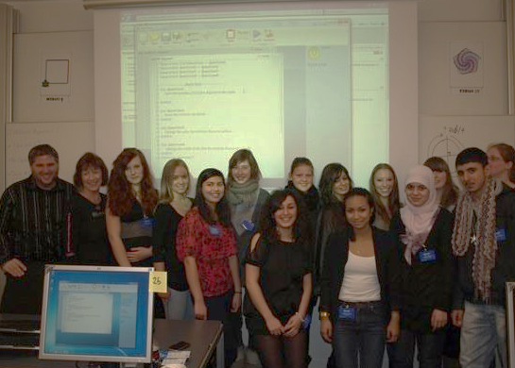
Where is TKP?
Co-founders have personally taught more than 2,000 kids

Slide 7
Setup
 | Teaching | Programming
Traditional | Long Setup | Manual Deploy
Modern | Immediate Setup | Single Click Deploy

Slide 8
Experience Areas
Setup – 0-15 minutes for 30 students
Recipe – 15-20 minutes
Recap – 5-10 minutes
Variation – 10-15 minutes
Quiz – 10-15 minutes
Deep Dive– 30-45 minutes
Worksheet – 15 minutes

Slide 9

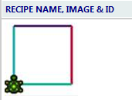
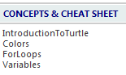
Experience 1: Recipe
Demo

Slide 10
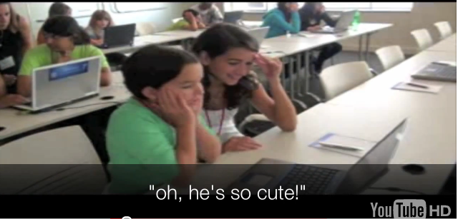
Experience 1:Recipe
Executing their 1st program within 2 minutes

Slide 11
Experience 1:Recipe
Executing their 1st program within 2 minutes
 | Teaching | Programming
Traditional | Conceptual Lecture | Full-blown Product
Modern | Engage & See | Minimum Marketable Feature

Slide 12
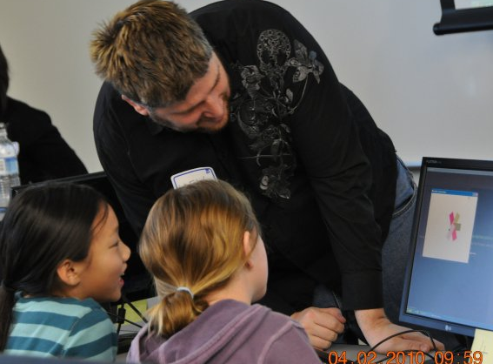
Experience 1: Recipe
Collaborative Learning

Slide 13
Experience 1:Recipe
Collaborative Learning
 | Teaching | Programming
Traditional | Individual Learning | Isolated Working
Modern | Pairing | Pairing

Slide 14
5 Rules of Accelerated Learning
KEEP IT ALIVE
HUNT FLUENCY
START OBVIOUS
STAY FOCUSED
ADAPT THE SETTING

Slide 15
Types of learning
Explicit
Experience
Fluency
Awareness
Inspiration
Confidence
Abstraction
Problem Solving

Slide 16
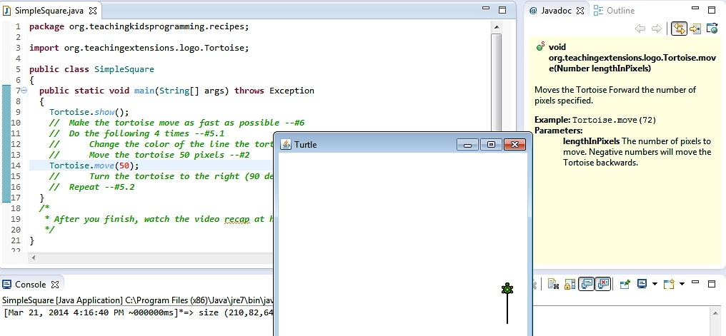
Experience 1: Recipe
1 line English = 1 verifiable line code i.e. lines 1,5,3, NOT 1, 2, 3

Slide 17
Experience 1:Recipe
1 line English = 1 verifiable line code i.e. lines 1,5,3, NOT 1, 2, 3
 | Teaching | Programming
Traditional | Big Exercises | Test After
Modern | Small Feedback Loop | Test First

Slide 18
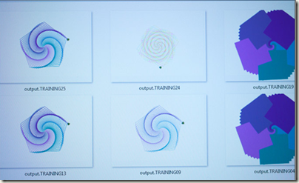
Experience 1: Recipe
Virtual Proctor

Slide 19
Experience 1:Recipe
Virtual Proctor
 | Teaching | Programming
Traditional | Turn in your Project | Feedback Releases
Modern | Rapid Feedback | Onsite Costumer

Slide 20
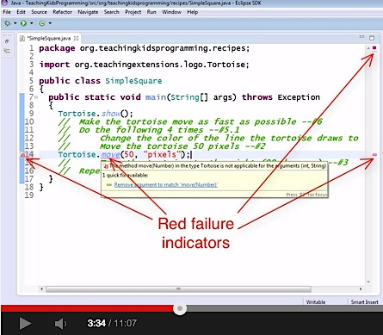
Experience 2: Recap
Demo

Slide 21
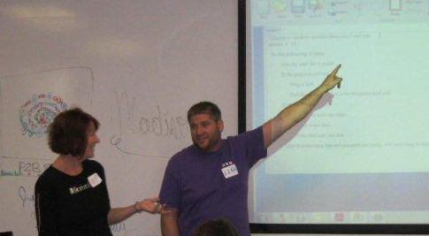
Experience 2: Recap
Exploring what we did
Notes:
6:20 in Houses recap

Slide 22
Experience 2:Recap
Exploring what we did
 | Teaching | Programming
Traditional | Conceptual First | Expert Staff
Modern | Recap | Retrospectives

Slide 23

Experience 2: Recap
Exploring Mistakes

Slide 24
Experience 2:Recap
Exploring Mistakes
 | Teaching | Programming
Traditional | Follow Directions | Don’t Make Mistakes
Modern | Explore | Learn from your Mistakes

Slide 25
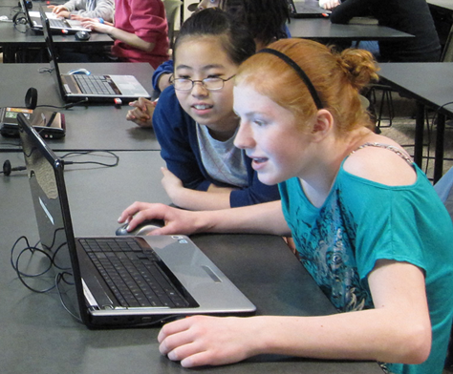
Experience 2: Recap
Discovering Patterns

Slide 26
Experience 2:Recap
Discovering Patterns
 | Teaching | Programming
Traditional | Lecture & Listen | Architecture
Modern | Emergent Concepts | Emergent Design

Slide 27
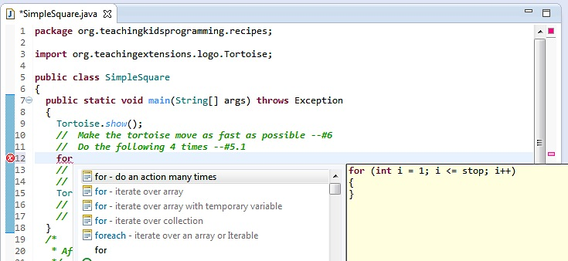
Experience 2: Recap
Learning to use your IDE

Slide 28
Experience 2:Recap
Learning to use your IDE
 | Teaching | Programming
Traditional | Don’t use calculators | Tool is powerful
Modern | Master your tools | Craftsmanship

Slide 29
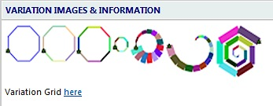
Experience 3: Variation
Demo

Slide 30
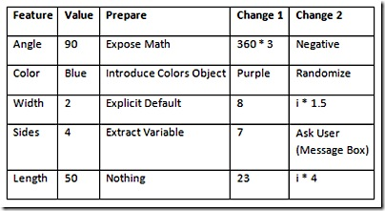
Experience 3: Variation
You can do the same thing with different code

Slide 31
Experience 2:Variation
You can do the same thing with different code
 | Teaching | Programming
Traditional | There is 1 right way | Repurposing
Modern | Refactoring | Refactoring

Slide 32
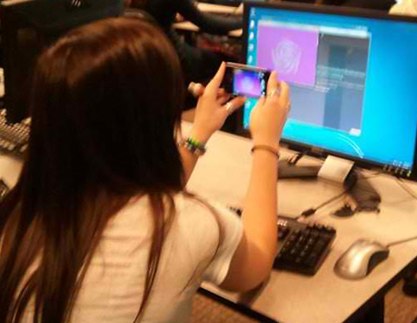
Experience 3: Variations
Joy, ownership

Slide 33
Experience 2:Variation
Joy, ownership
 | Teaching | Programming
Traditional | Learning is Serious | Resources
Modern | Learning is Joyful | People

Slide 34
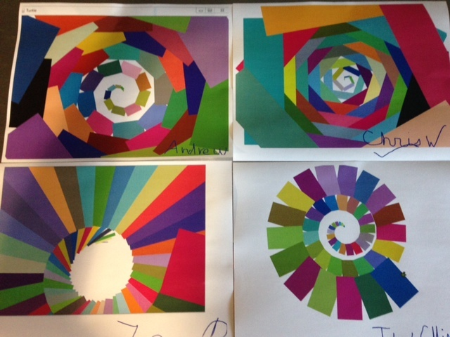
Experience 3: Variation

Slide 35
Experience 3:Variation
Variations
 | Teaching | Programming
Traditional | Teach whole concept | Big Upfront Design
Modern | Iterative Learning | Incremental & Iterative

Slide 36
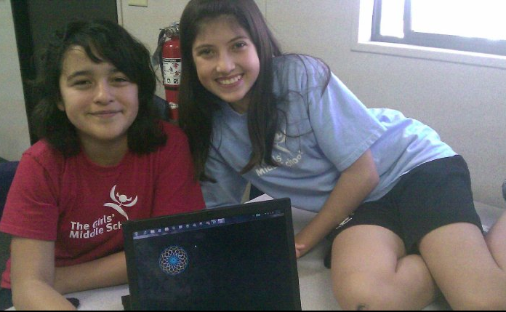
Experience 3: Variation
Coding is Joy

Slide 37
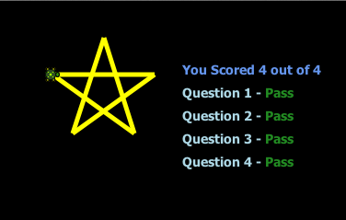
Experience 4: Quiz
Demo

Slide 38
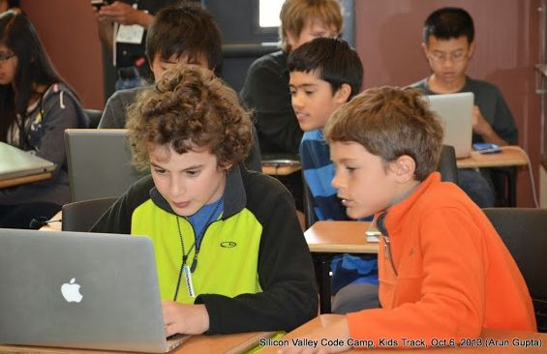
Experience 4: Quiz
Teaching from the back of the room

Slide 39
Experience 4:Quiz
Teaching from the back of the room
 | Teaching | Programming
Traditional | Lecture, Lab Assist, Grader | Specialist
Modern | Facilitator & Teacher | Cross Functional Team

Slide 40
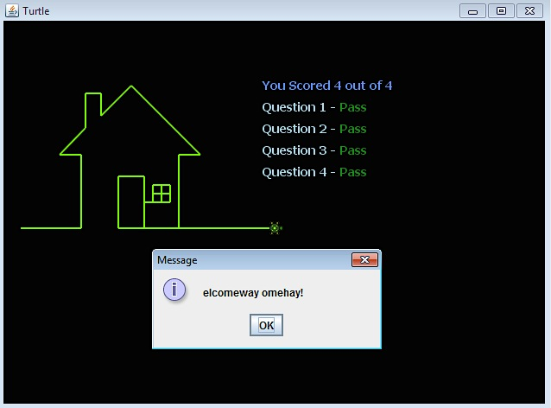
Experience 4: Quiz
½ way done

Slide 41
Experience 4:Quiz
½ way done
 | Teaching | Programming
Traditional | Grades tomorrow | QA
Modern | Red…Green | Red…Green

Slide 42
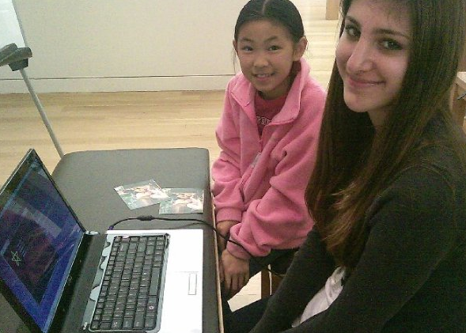
Experience 4: Quiz
100% of pairs get 100% right

Slide 43
Experience 4:Quiz
100% pass rate
 | Teaching | Programming
Traditional | Quizzes show what you didn’t learn | Release Criteria
Modern | Quizzes show what you did learn | Continuous Intergration

Slide 44
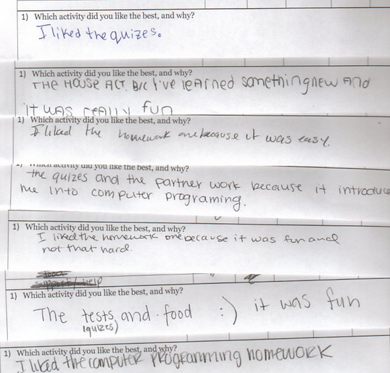
Experience 4: Quiz
Quizzes
are rewards

Slide 45
Experience 4:Quiz
Quizzes are rewards
 | Teaching | Programming
Traditional | Quizzes suck! | Death March
Modern | Learning rocks! | Happiness Matters

Slide 46
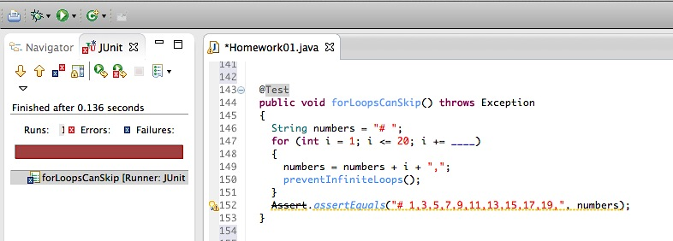
Experience 5: Enrichment
Demo

Slide 47
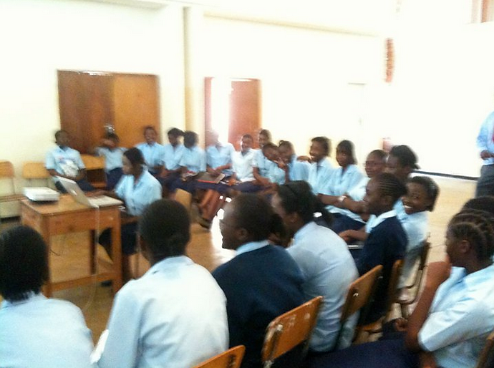
Experience 5: Deep Dive
Group learning

Slide 48
Experience 5: Deep Dive
Group Learning
 | Teaching | Programming
Traditional | Solo | Solo
Modern | Randori | Mobbing

Slide 49
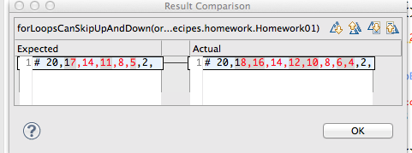
Experience 5: Deep Dive
Experiment, run and try (again) → good hacking!

Slide 50
Experience 5: Deep Dive
Experiment, run and try (again) → good hacking!
 | Teaching | Programming
Traditional | Time is fixed, mastery will vary | Fixed Scope
Modern | Mastery is fixed, time will vary | Potentially Shippable

Slide 51
Experience 6: Worksheet
Written exercise to verify conceptual understanding
 | Teaching | Programming
Traditional | Abstract Concepts 2) Labs | Architecture Code
Modern | Labs Recognize Abstractions | Code Emergent Design

Slide 52
Worksheet example

Slide 53
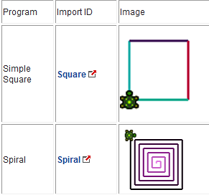
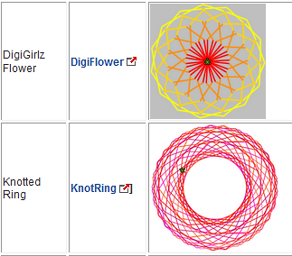
Experience 7: Extras
Mini recipes
Warm-ups or fill-ins if pairs finish early
Could also be done alone to verify mastery of concepts

Slide 54
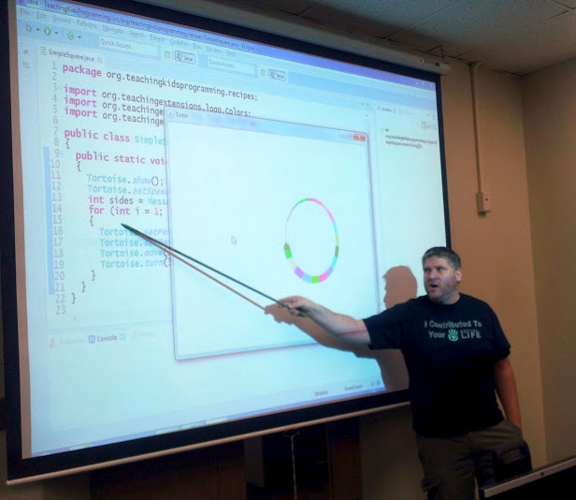
Next Steps For Teachers
Try out the content – do the recipes

Slide 55
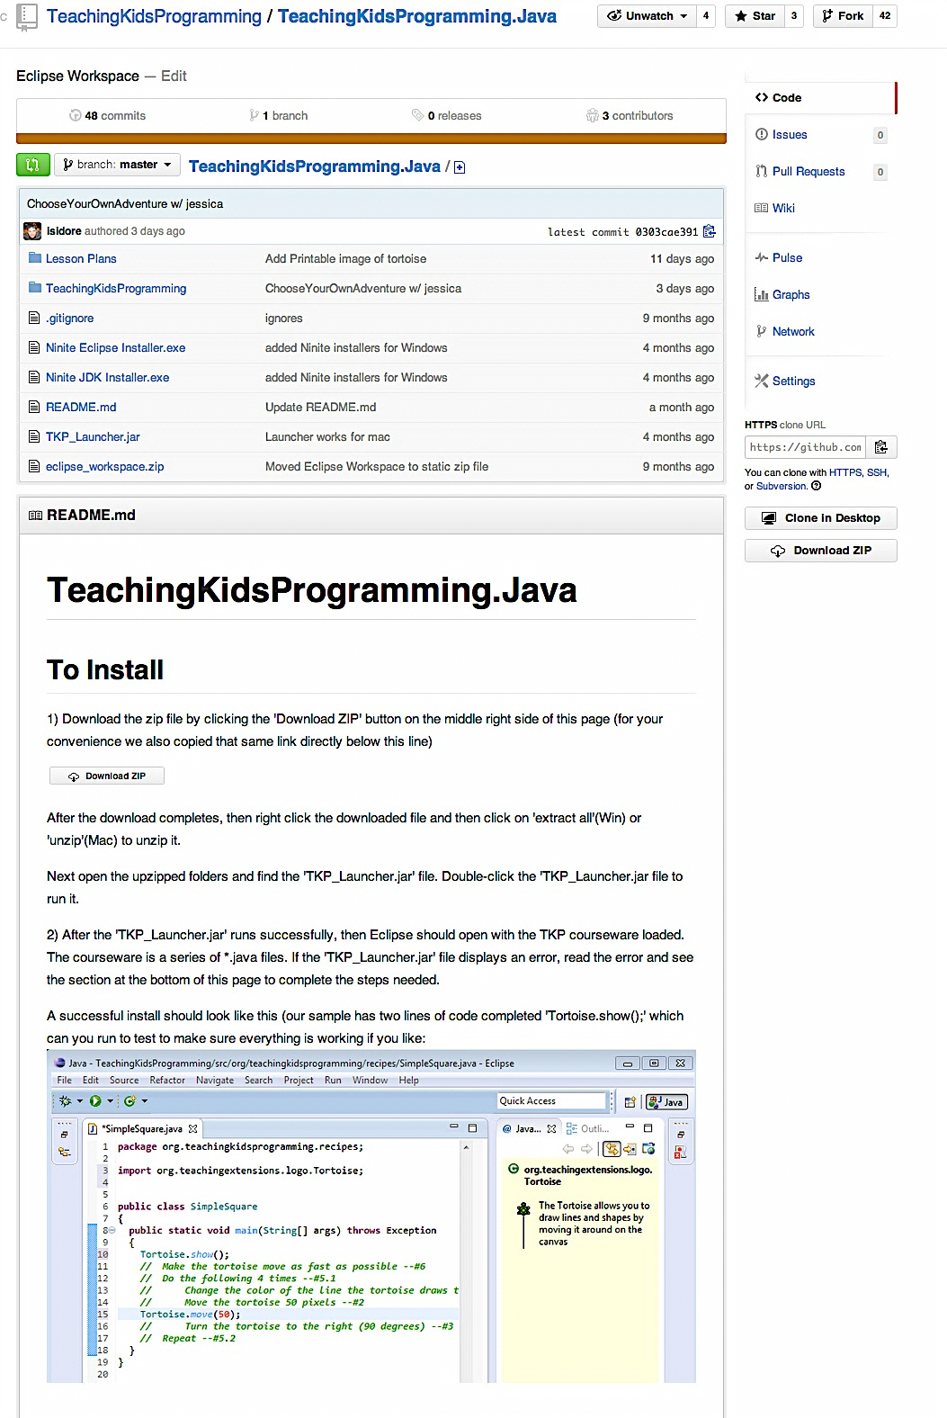

GitHub
lfal.co/tkpjava

Slide 56
TKP Java Courses
Using Objects, Methods & For Loops
Creating Methods
If statements
Code Mastery
Recursion
Model View Controller
Events
Test Driven Development

Slide 57
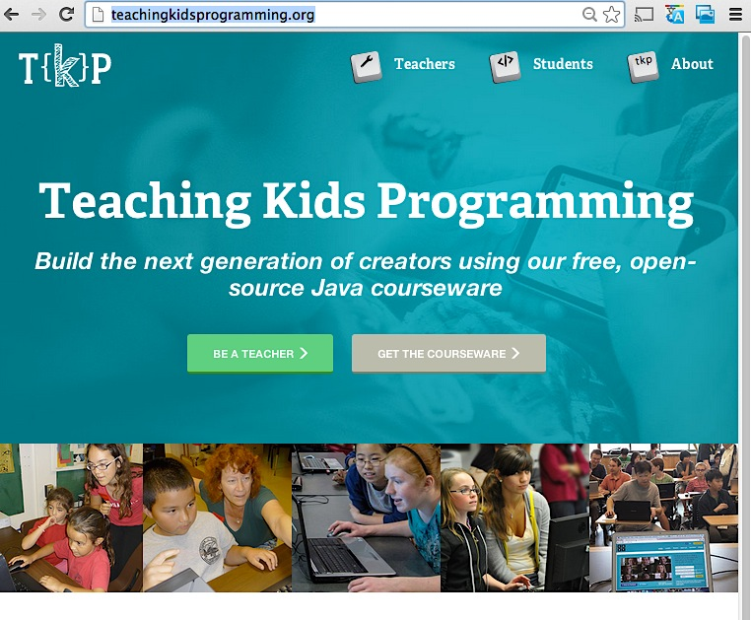
Get started teaching
Go to the Teachers section of the TKP site Download the free lesson plans

Slide 58
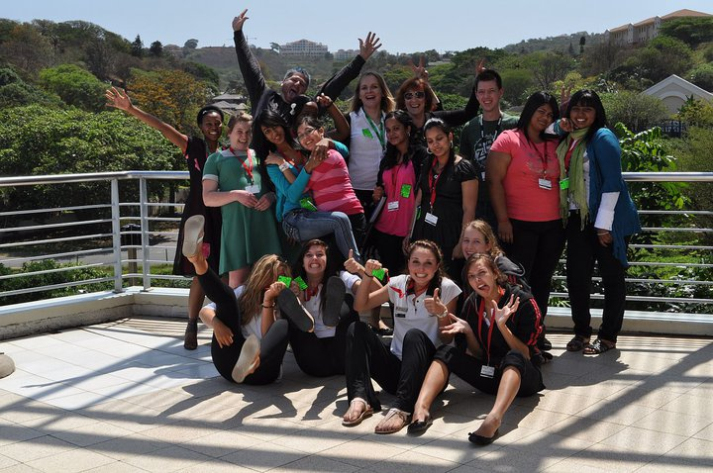
@Llewellyn Falco
www.ApprovalTests.com
@LynnLangit
www.lynnlangit.com
Notes:
Both

